Slide 1




Slide 2
We are now a Step Up. Step In. School!

Slide 3


And we need YOUR help!
To create a better school culture
To treat each other more respectfully
To stop certain behaviors from happening

Slide 4


Raise Your Hands
If you have ever been …
Picked on
Flirted with in a way that made you uncomfortable
The subject of a rumor
Teased or joked with in a way that didn’t seem funny
Bullied

Slide 5
Who’s Surprised by how many people raised their hands?
That’s why we’re here today.
So that fewer hands will be raised
when we ask these questions.

Slide 6

A Specific Kind of Bullying
Stop Sexual Bullying
Sexual words, acts, images, threats, or any other behavior in any manner that distress, harm, taunt, demean, humiliate, and/or embarrass a peer who does not welcome, encourage, or want to participate in the exchange.

Slide 7

What is Sexual Bullying?
Sexual photos / sexting
Name calling
Teasing someone for perceived sexuality
Spreading rumors
Sexual conversations
Suggestive comments
Groping/grabbing others
And more

Slide 8
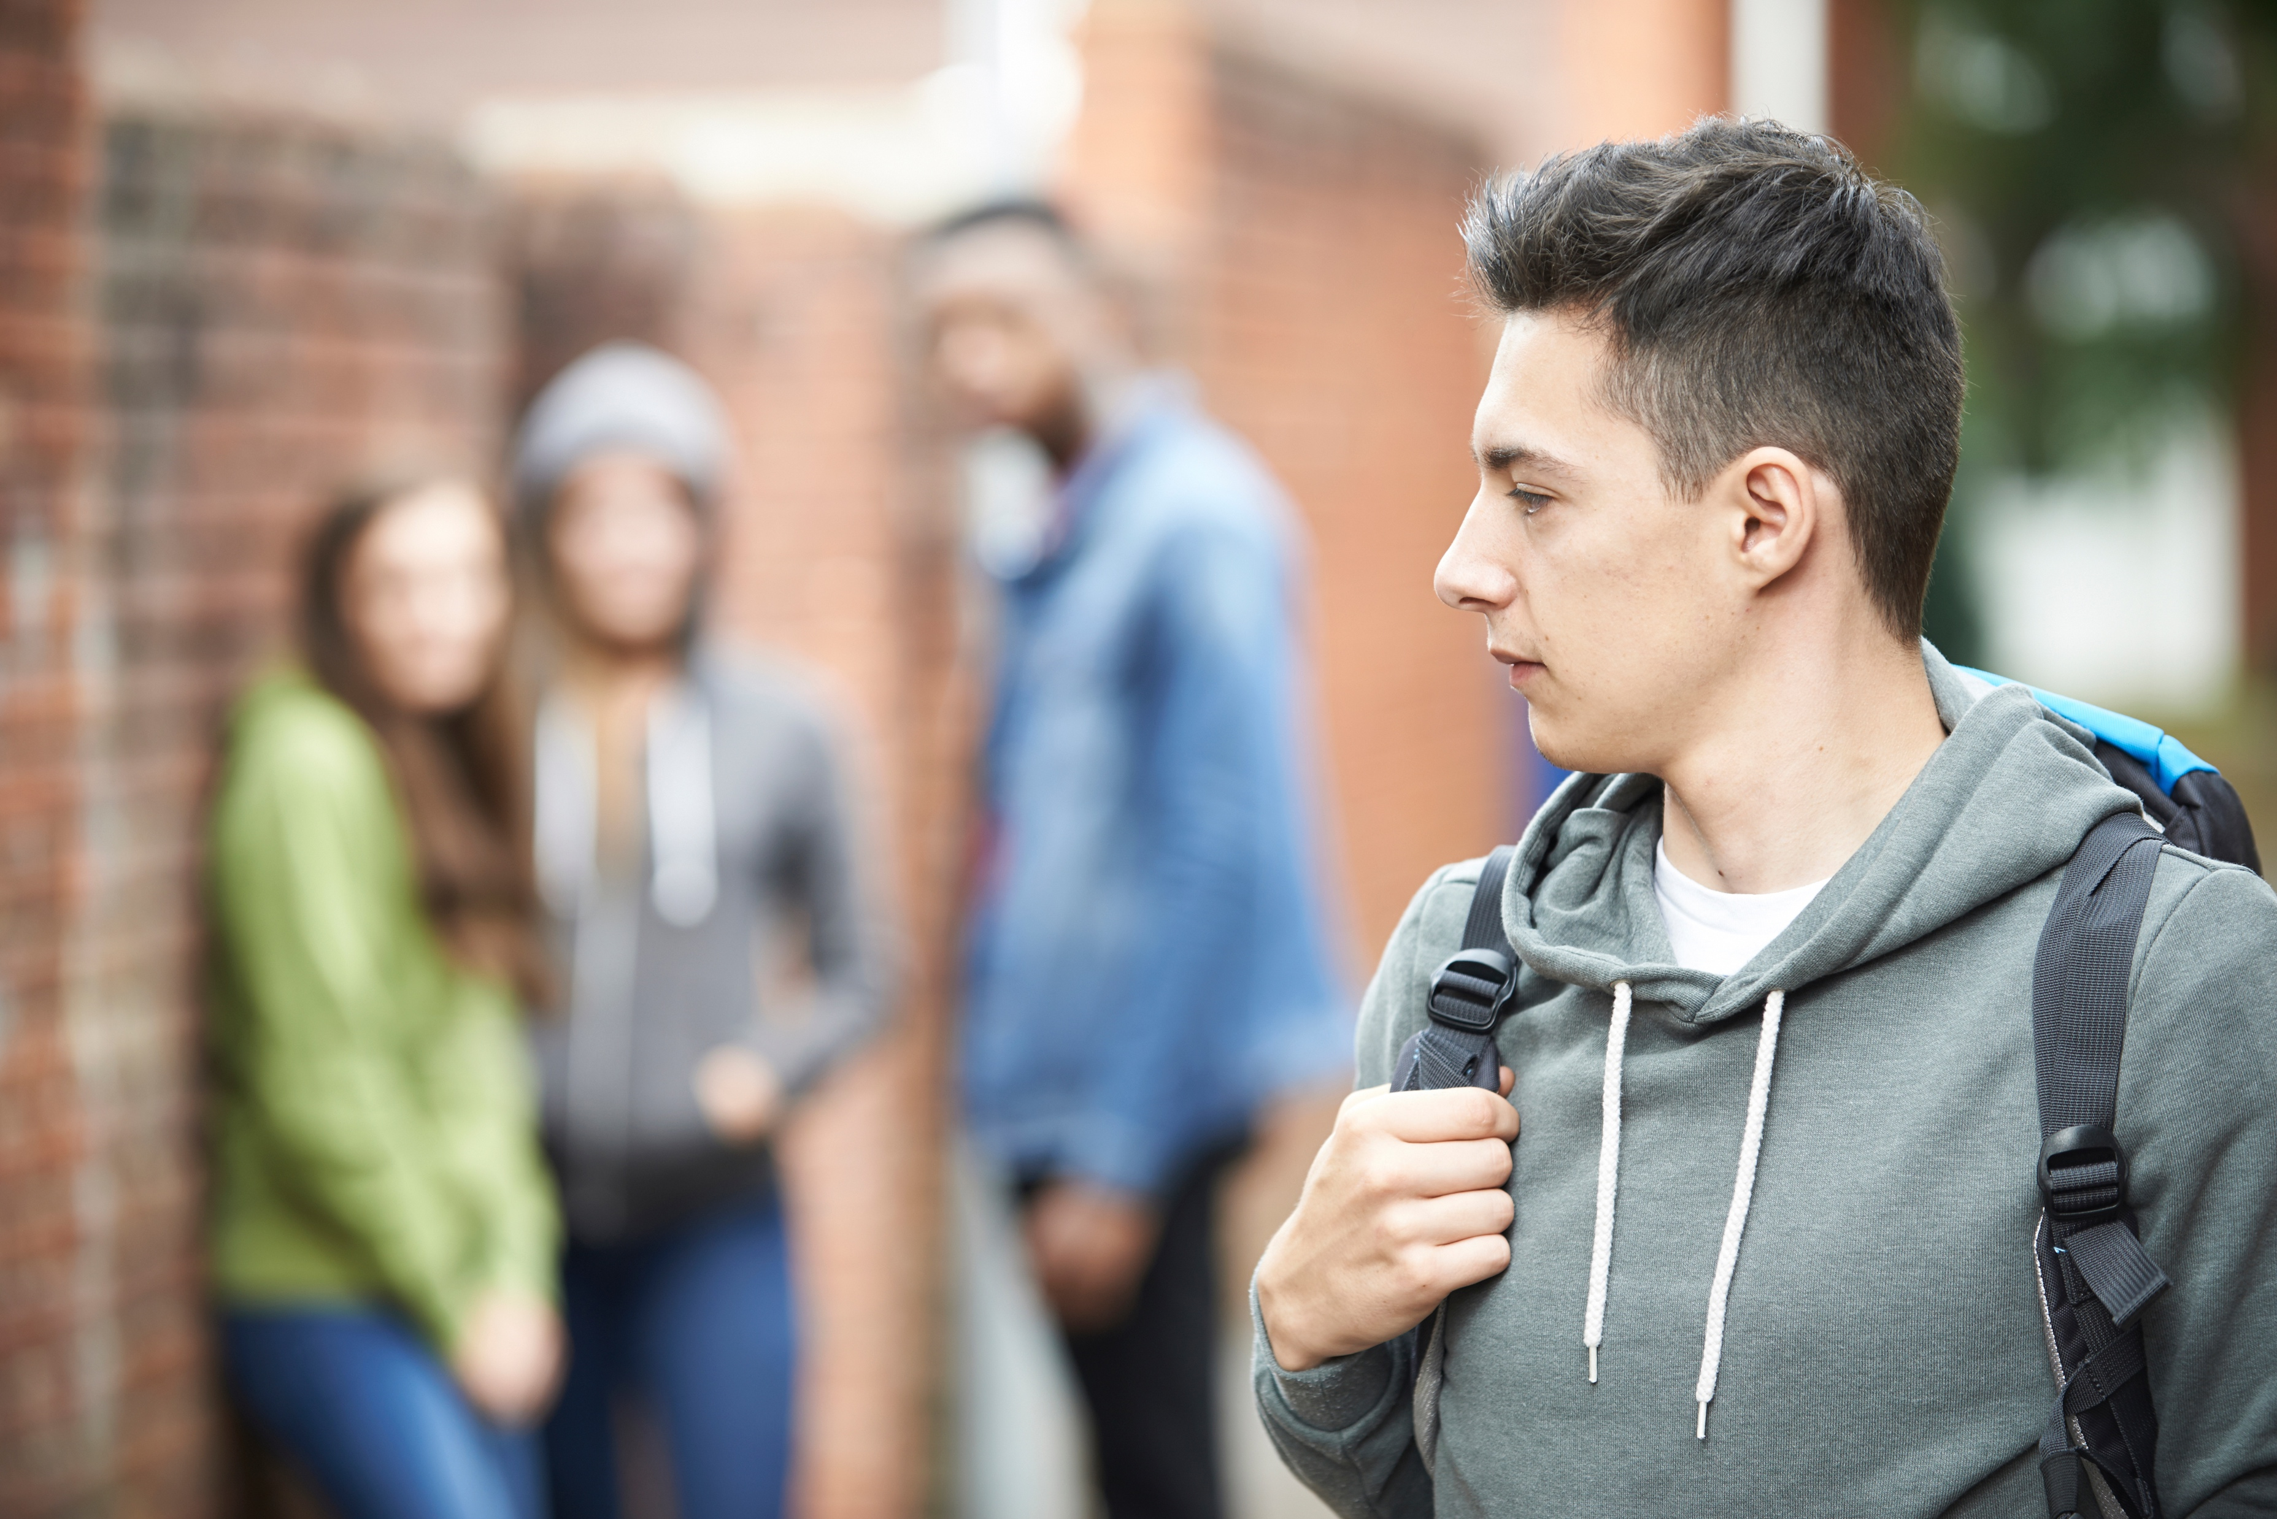

How Do We Stop Sexual Bullying?
Stop

Slide 9
How Do We Stop Sexual Bullying?
By knowing what sexual bullying is – and by understanding it is wrong
  Sexual bullying is not funny
  Sexual bullying is not teasing
  Sexual bullying is not flirting
  Sexual bullying is not a joke
By not doing it, participating in it, or encouraging it
By stopping it when we see others being sexually bullied – and by knowing what to do when it happens to you
Stop

Slide 10
What Can You Do?
The Do’s and Don’ts

Slide 11


Don’t
Do not sext – including taking, sending, forwarding or posting any sexual photos of yourself or others.
What if it’s sent to me?
Don’t send, forward, or post any sexually explicit photos you receive
Tell a trusted adult

Slide 12

Don’t
Do not use social media or mobile apps to write sexual, derogatory, nasty, mean, untrue or any kind of negative message about anyone else.
What if it’s happening to me?
Do not be embarrassed!
Immediately take what you see to a trusted adult – do not try to handle it alone

Slide 13

Don’t
Do not call anyone names or derogatory terms – do not or try to shame them based on rumors, perceived sexuality, or for any other reason.
What if it happens to me?
Tell them to stop
Tell a trusted adult if it continues

Slide 14
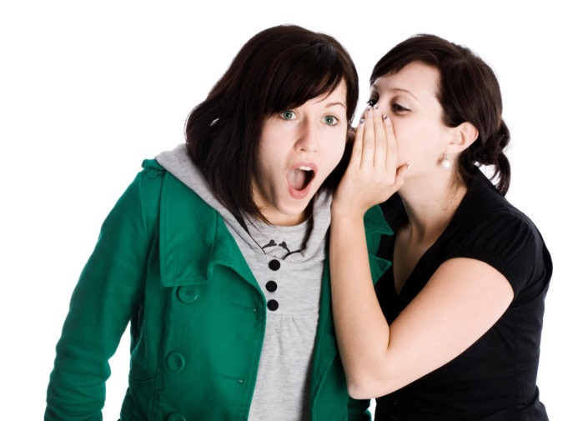
Don’t
Do not spread sexual rumors about anyone.
Let the rumor stop with you.
Ask for help! Tell a trusted adult if a rumor is being spread about you or a classmate.

Slide 15
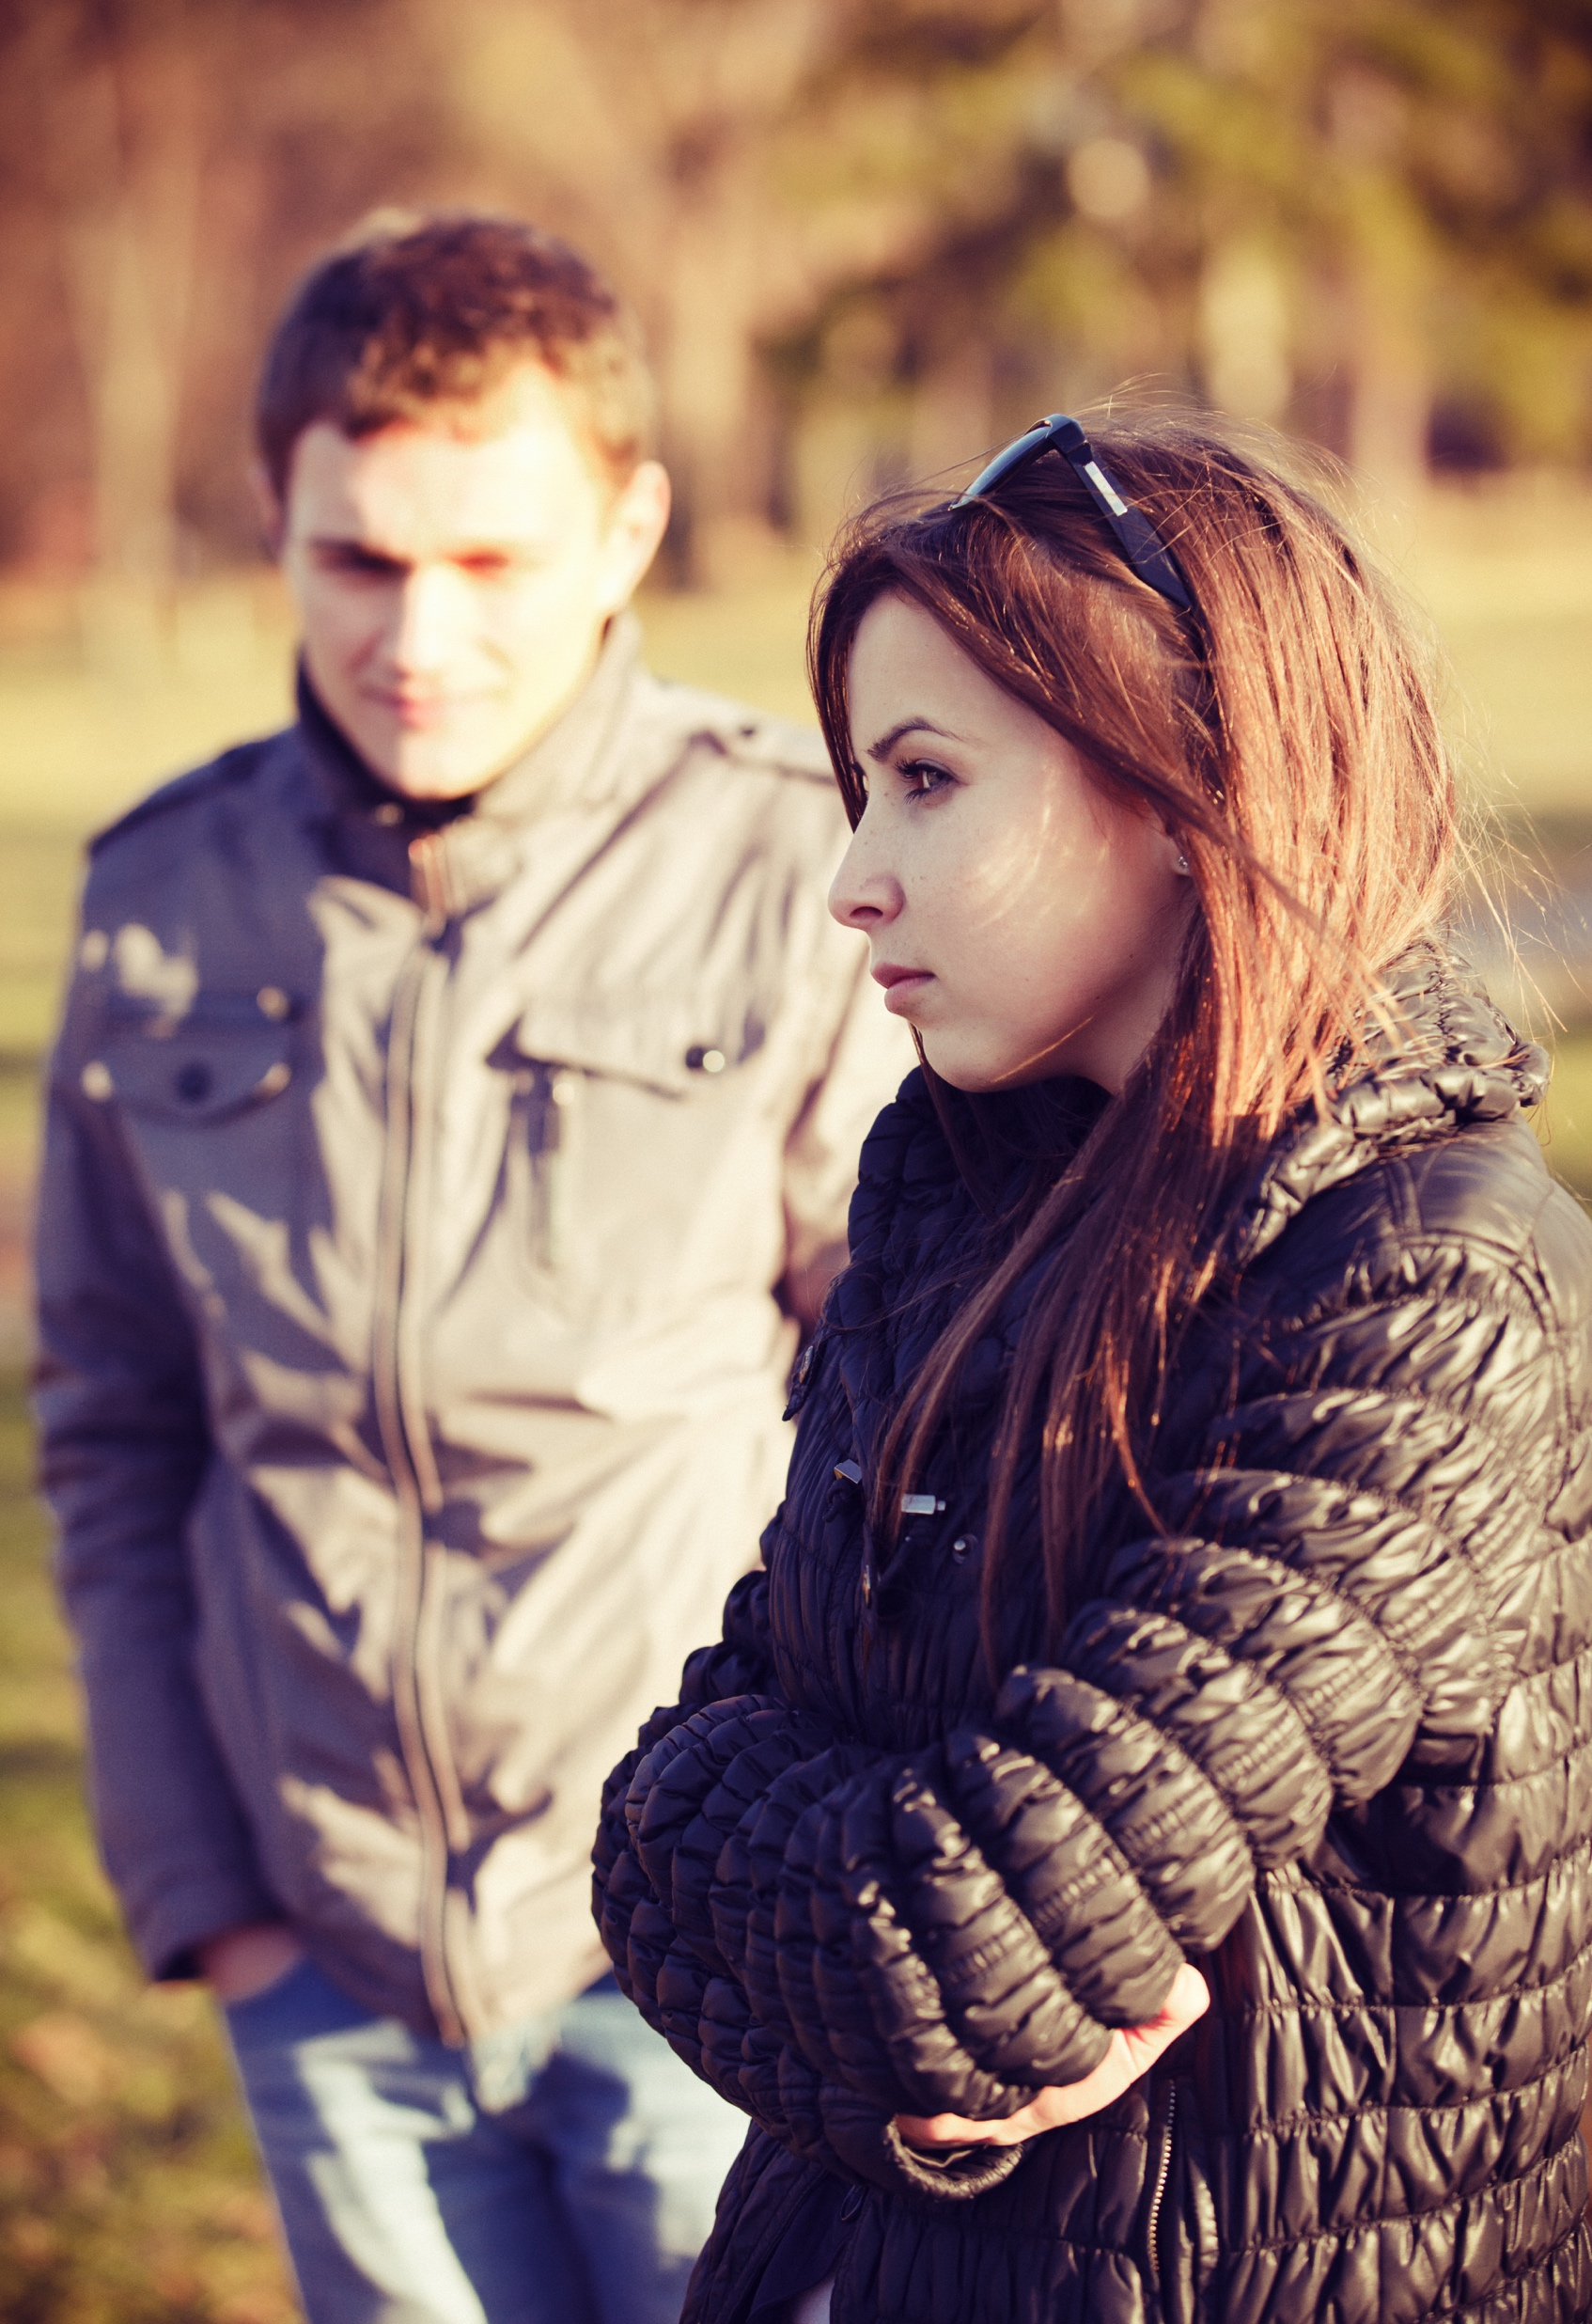
Don’t
Do not flirt with anyone forcefully and in a way that seems to make them uncomfortable.
What if it happens to me?
Tell the other person to stop and leave you alone
If they persist, tell a trusted adult

Slide 16
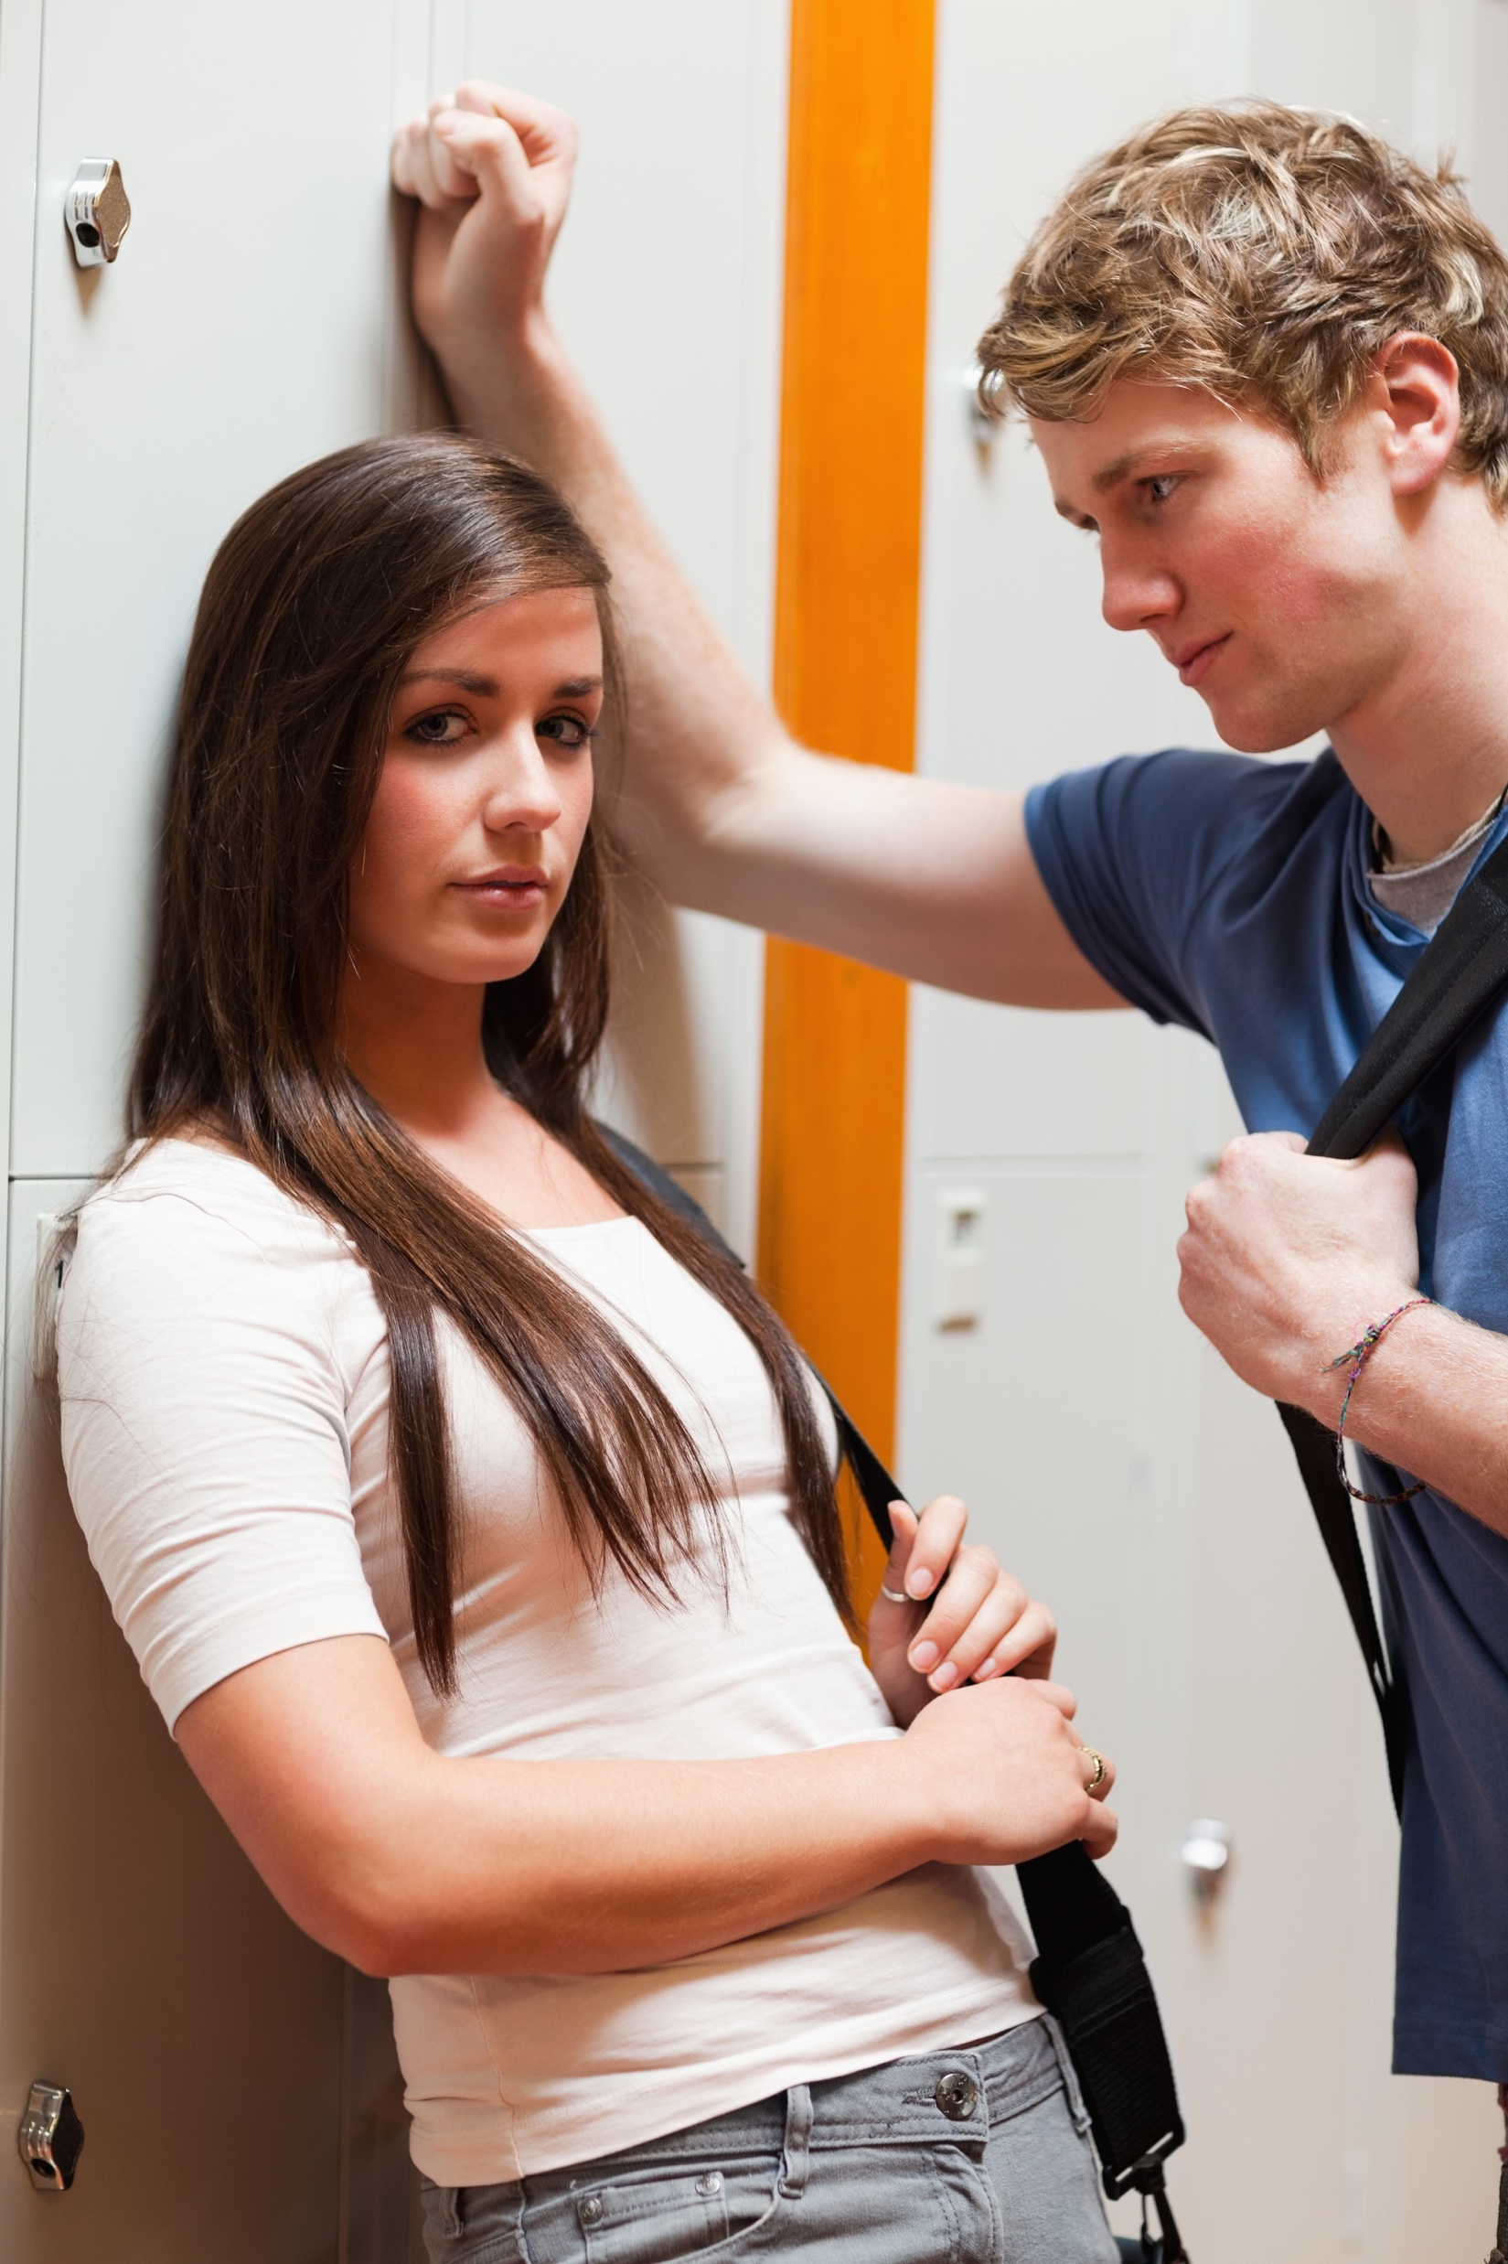
Don’t
Do not touch or grope anyone – keep your hands to yourself.
What if it happens to me?
Step away
Tell the other person to stop and to leave you alone
If they persist, tell a trusted adult

Slide 17
Don’t
Do not make sexually suggestive comments to anyone.
What if it happens to me?
Walk away
Tell the other person to stop and to leave you alone
If they persist, tell a trusted adult

Slide 18


What Else Can You Do?
Get help! Tell an adult
If it happens to you
If you observe it happening to someone else
If you suspect or hear about it happening to someone else
Intervene
When you feel comfortable doing so
Do not participate or encourage any form of sexual bullying

Slide 19




Questions and Answers

Slide 20
Take the First Step
Sign the Step Up. Step In. pledge and commit to:
  Stopping sexual bullying
  Not encouraging or participating in sexual bullying
  Helping others who are sexually bullied by intervening, telling a trusted adult or other ways
  Always treating each other with respect
  And understanding that your actions can and will have consequences

